Slide 1
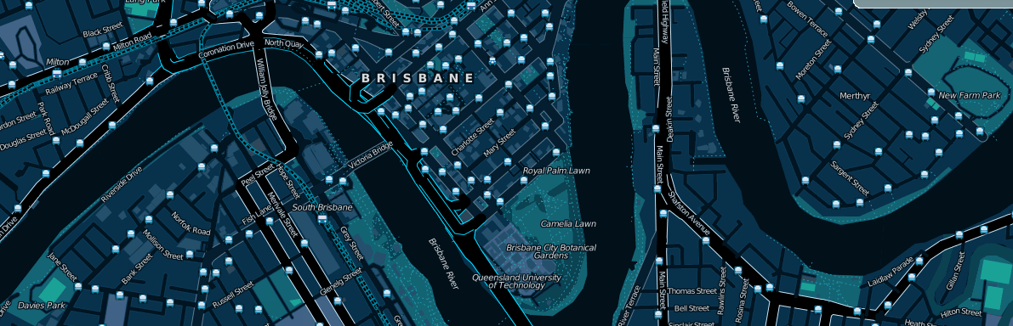
An introduction to OpenStreetMap presented by David Dean http://www.dbdean.com

Slide 2

What is OpenStreetMap?
Geographic data
  For driving, riding, walking, boating, skiing, hiking, anything
Free
  Currently CC-BY-SA, moving to ODBL
Wiki-like editing
http://www.osm.org

Slide 3
Why not just use Google Maps?
or WhereIs/Yahoo/Bing Maps?
or whatever is on your GPS/Phone?

Slide 4


Updated rapidly
Google
OpenStreetMap

Slide 5
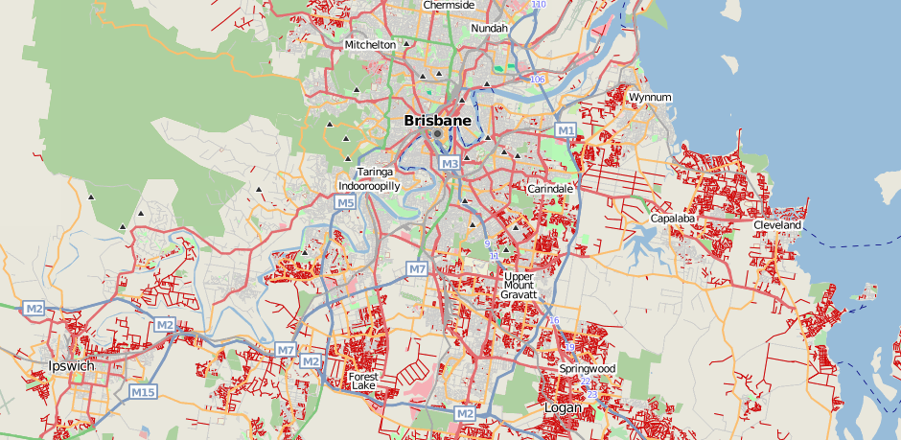
But, coverage can be poor

Slide 6



Not just for cars

Slide 7

Data freely available (and editable)

Slide 8

Raw traces are available too

Slide 9




Free data means you can do more neat stuff

Slide 10
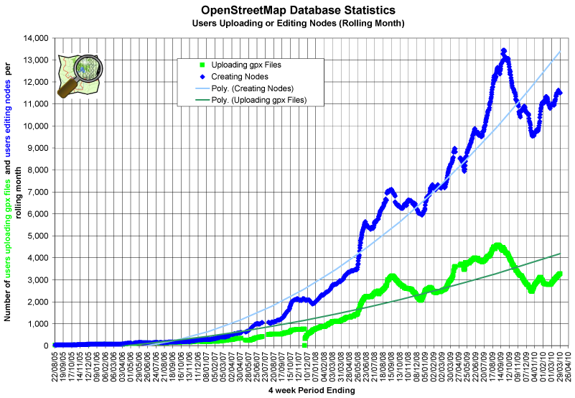
Lots of Mappers

Slide 11
Worldwide activity
OSM 2008: A Year of Edits

Slide 12
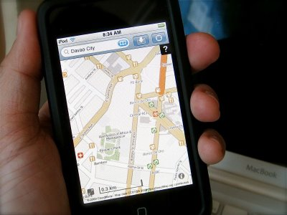
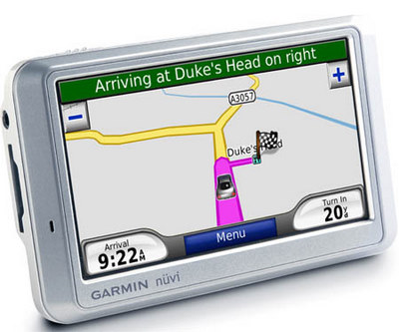
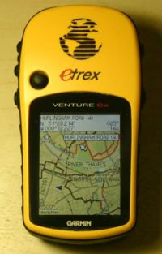
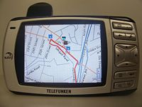
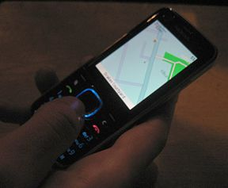
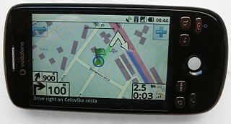
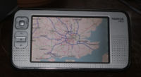
Available on many devices
Garmin PNDs
OffMaps on IPhone
Garmin GPSs
Gosmore on Windows Mobile
AndNav2 on Android
GPSMid on J2ME
MaemoMapper on Nokia Maemo

Slide 13
Humanitarian OpenStreetMap Team

Slide 14
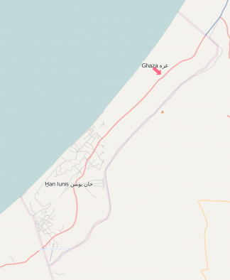
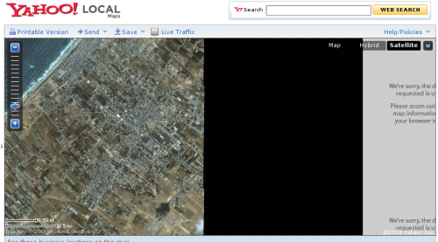
OpenStreetMap Gaza Project
Jan 2009: Mikel Maron announces OpenStreetMap Gaza Project
Feb 2009: Mapping begins with purchased aerial imagery
(~ $6000)

Slide 15
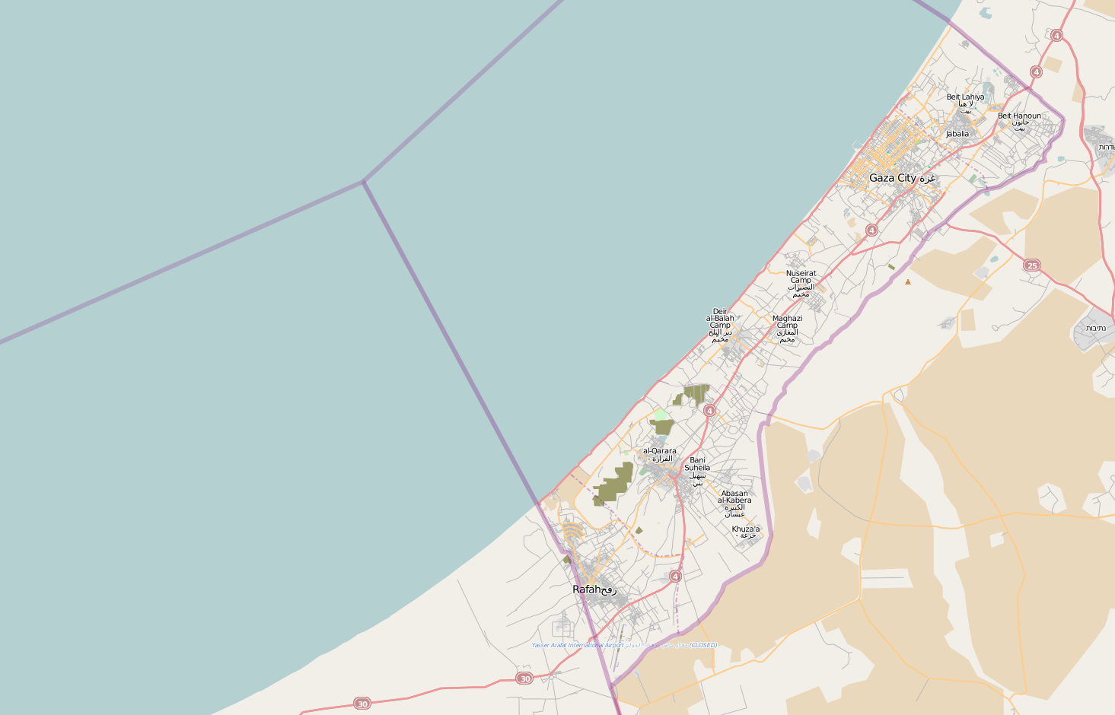
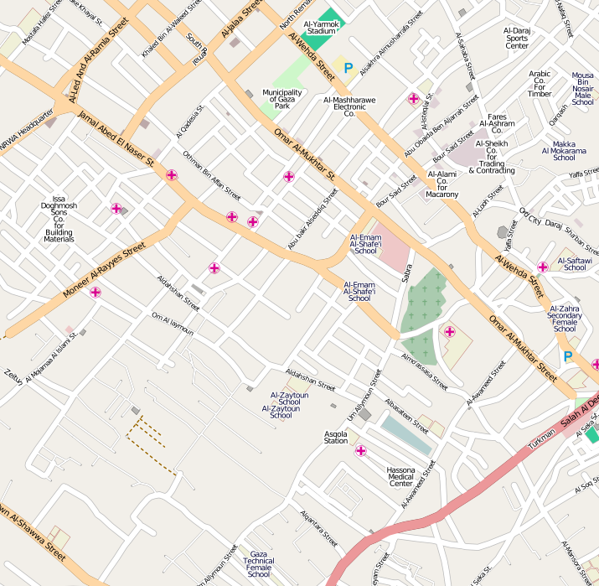
Gaza Strip today

Slide 16
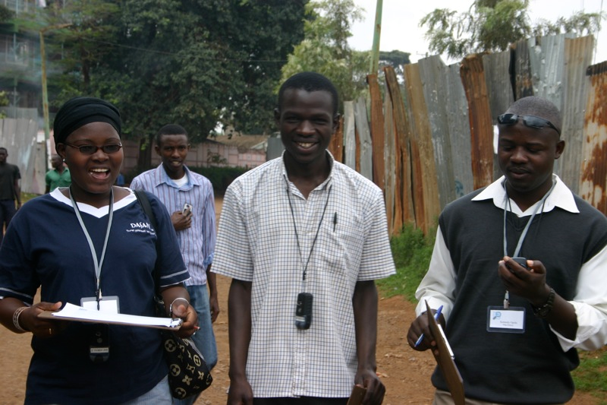
MAP Kibera (April 2009)
First complete, free and open map of Kibera, Nairobi.
Mapped primarily
with local volunteers
with the assistance
of MAP Kibera.
http://mapkibera.org

Slide 17
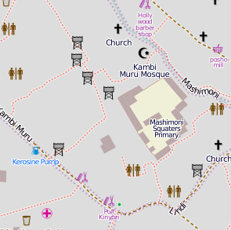
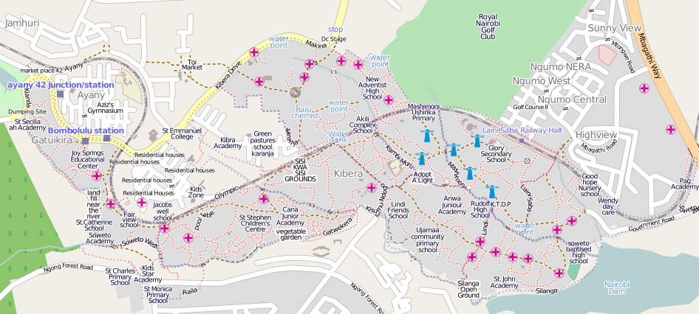
Kibera today

Slide 18

Haiti earthquake, Jan 2010

Slide 19

Haiti earthquake, Jan 2010
High-res imagery donated this time. (many providers)

Slide 20
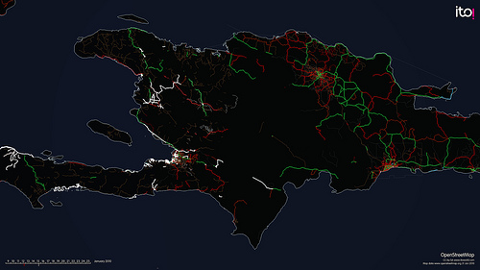
Haiti earthquake, Jan 2010
High-res imagery donated this time. (many providers)

Slide 21
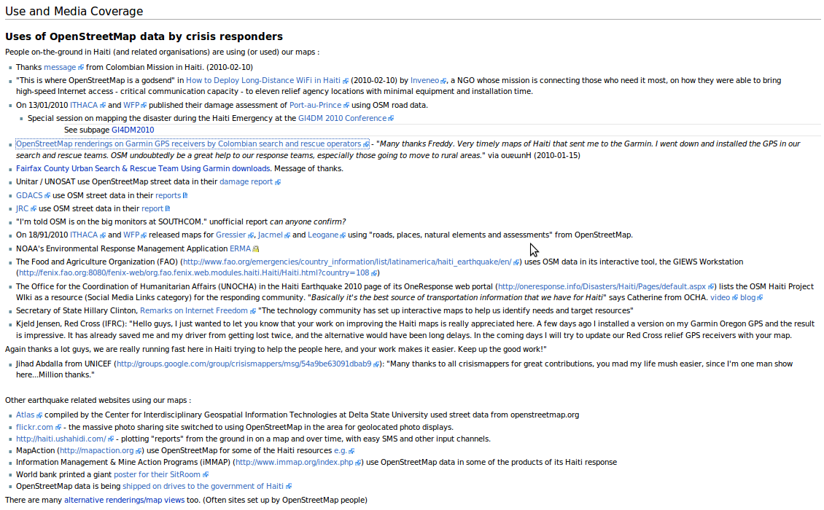
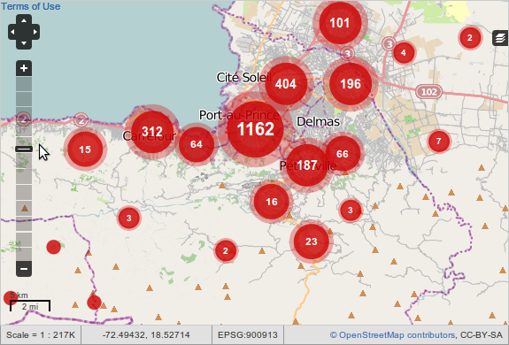
http://haiti.ushahidi.com

Slide 22
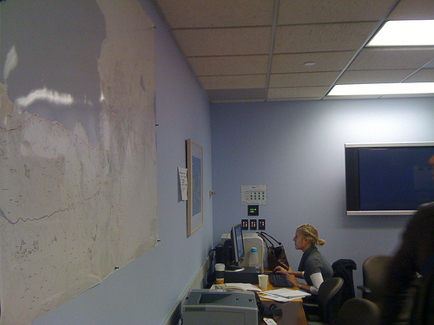
World Bank Situation Room
http://haiti.ushahidi.com

Slide 23

"Hello guys, I just wanted to let you know that your work on improving the Haiti maps is really appreciated here. A few days ago I installed a version on my Garmin Oregon GPS and the result is impressive. It has already saved me and my driver from getting lost twice, and the alternative would have been long delays. In the coming days I will try to update our Red Cross relief GPS receivers with your map.” - Kjeld Jensen, Red Cross (IFRC)
World Bank Situation Room
http://haiti.ushahidi.com

Slide 24
So, how can you map?

Slide 25

(Option 1) Trace aerial imagery

Slide 26


(Option 2) Go outside
Take notes, →
record your trip (optional),
and update the map from your notes at home

Slide 27
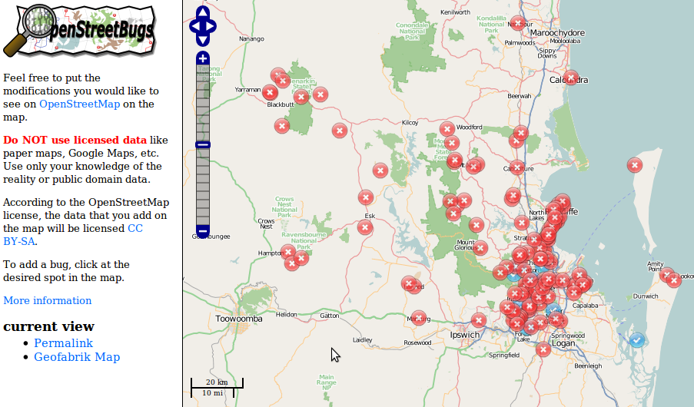
(Option 3) Tell someone about a problem

Slide 28

(Option 4) Be social
Brisbane mapping events occur monthly
  Alternate between mapping parties and meetups
Next event: OSM Mapping Meetup
  7pm Monday 21st June at Grange Library
  See http://wiki.osm.org/wiki/Brisbane
What is a mapping party?
  A group of people get together to map a large area in a single day
  Example: Macleay Island in November 2009

Slide 29

Data representation
Geographic information is represented as
  Nodes
  Ways
    Ordered collections of nodes
    Closed ways can be areas
  Relations
    Ordered collections of ways and nodes
All can be tagged with any key/value pairs

Slide 30


No formal key/value ontology
Let freedom flourish!
Common tagging is encouraged
  Map Features wiki
  Editor presets
  Renderers
  OSMDoc
  Tagwatch

Slide 31

Questions/Suggestions?
Thanks for listening.

